Slide 1

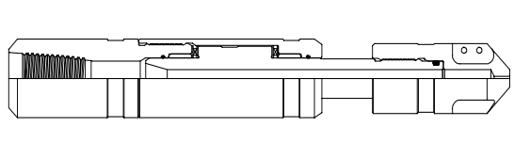
Thru-Tubing Fishing Spinning Wash Tool
Editor: Jalal Alali
2018.05

Slide 2
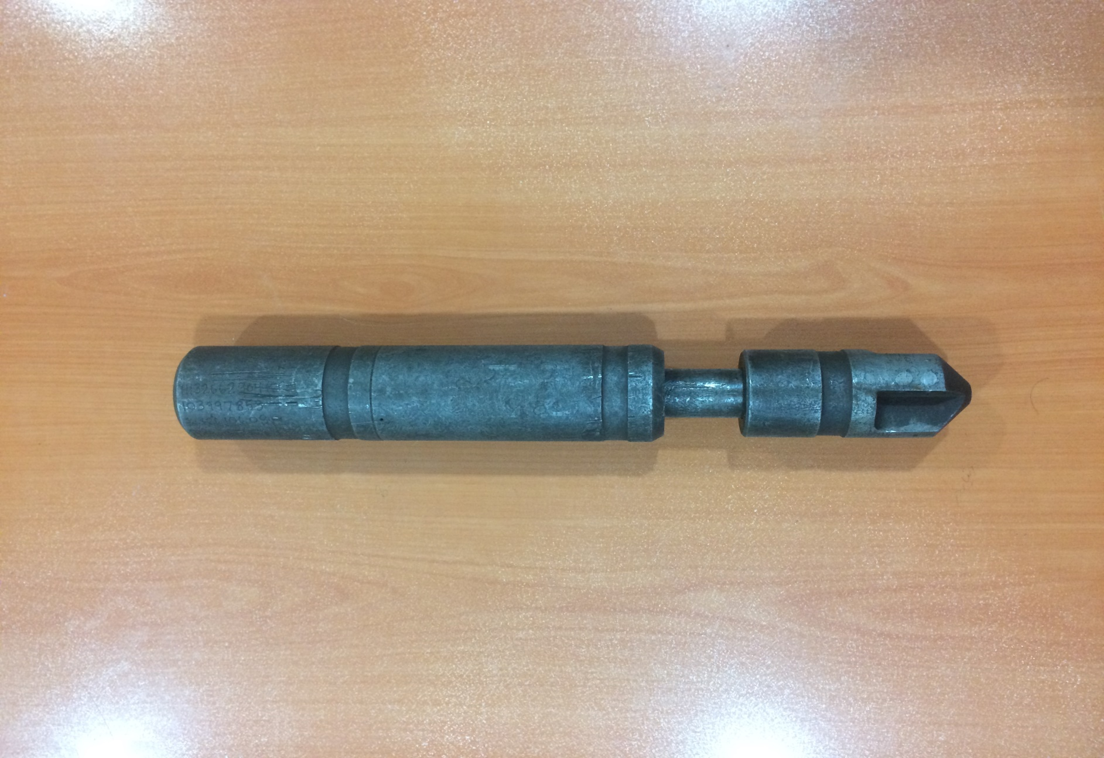

Slide 3
CONTENT
Introduction of TOOL
Disassembly
Assembly

Slide 4
The High Flow Spinning Wash Tool provides an efficient means of washing sand and debris . Fluid is pumped through a rotating nozzle that directs the flow to the bottom and sides of the hole . The rotation of the nozzle insures that all of the surfaces being washed are impacted by the wash fluid . Large ports in the nozzle allows for a high flow rate .
Introduction:

Slide 5
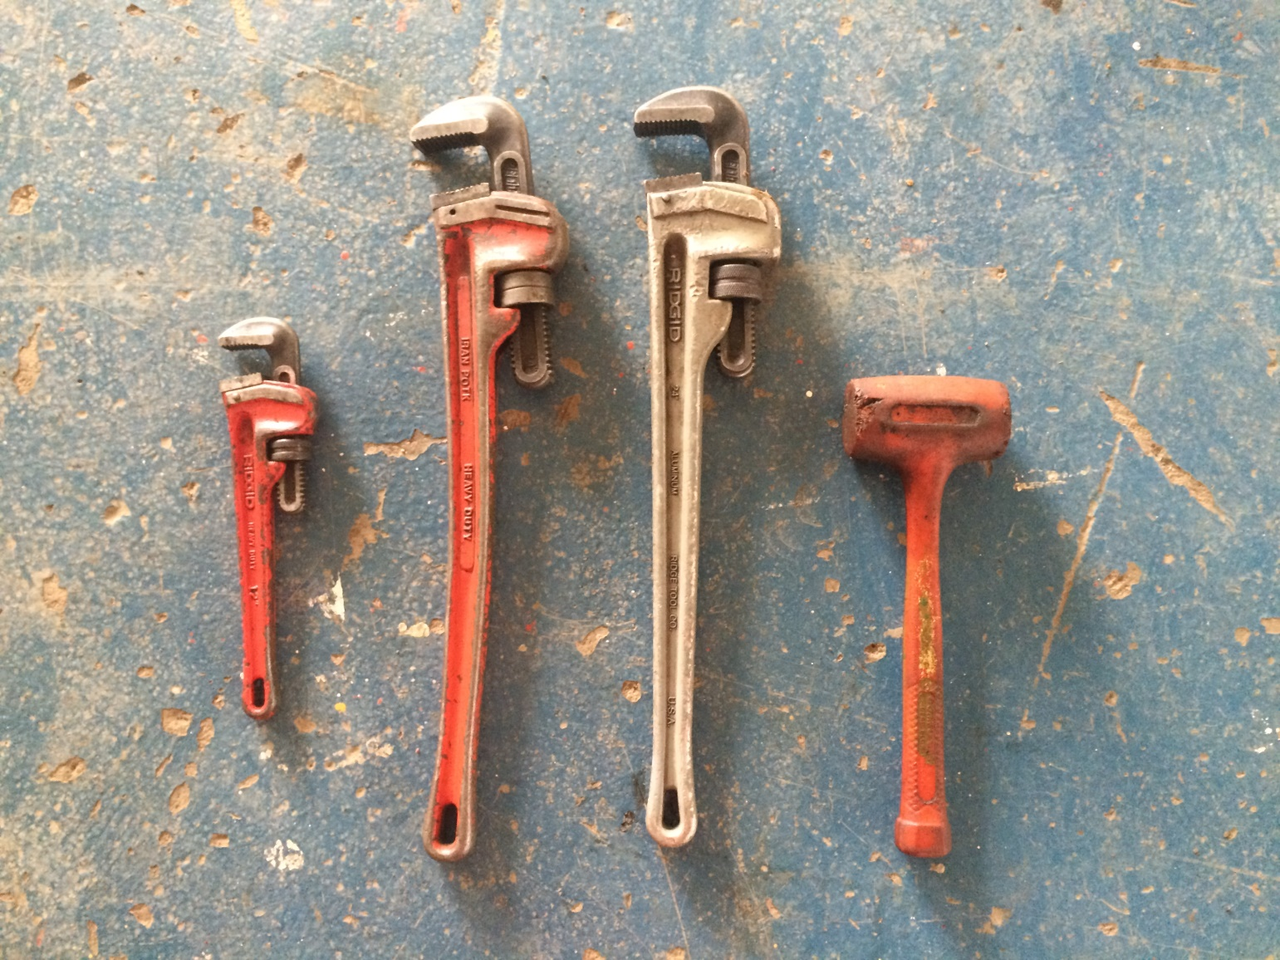
Required hand tools
Pipe Wrench
Plastic hammer

Slide 6
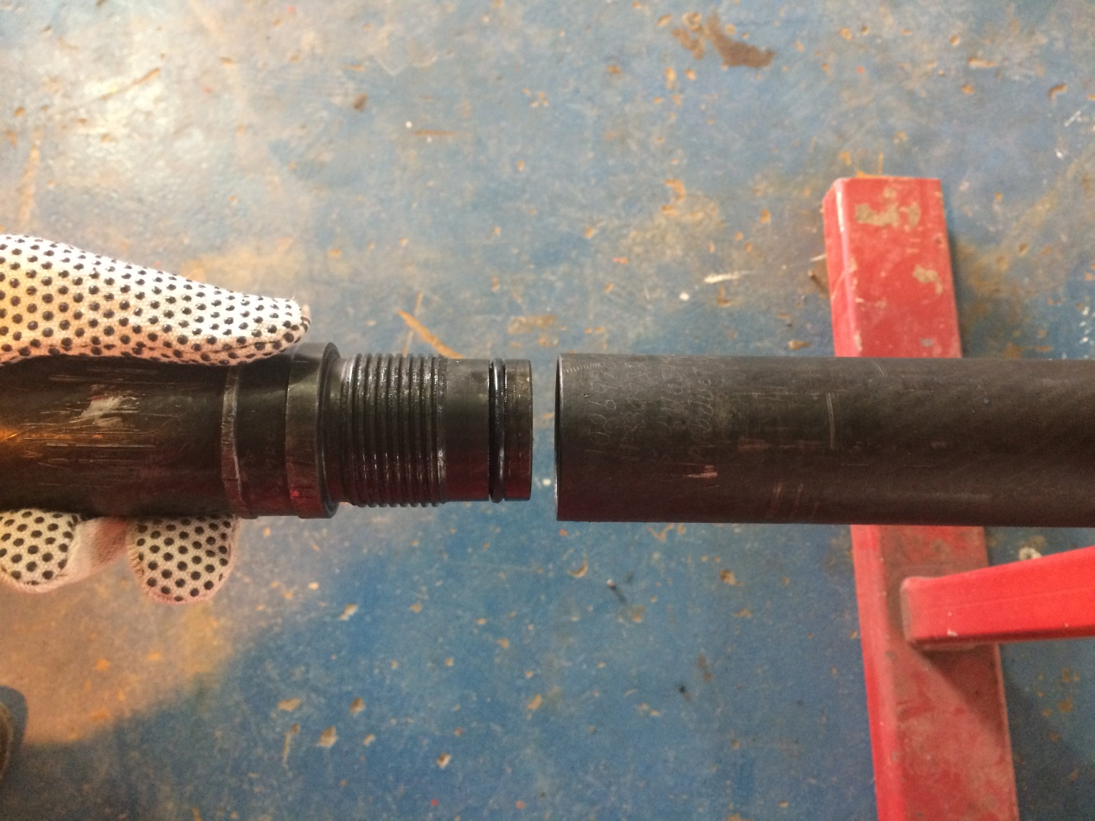
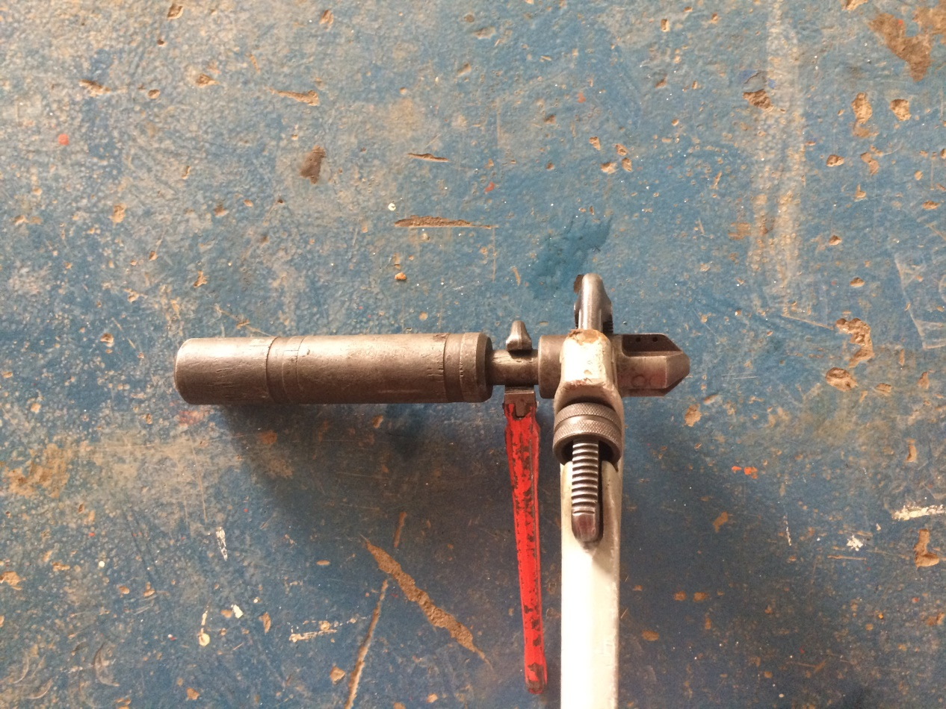
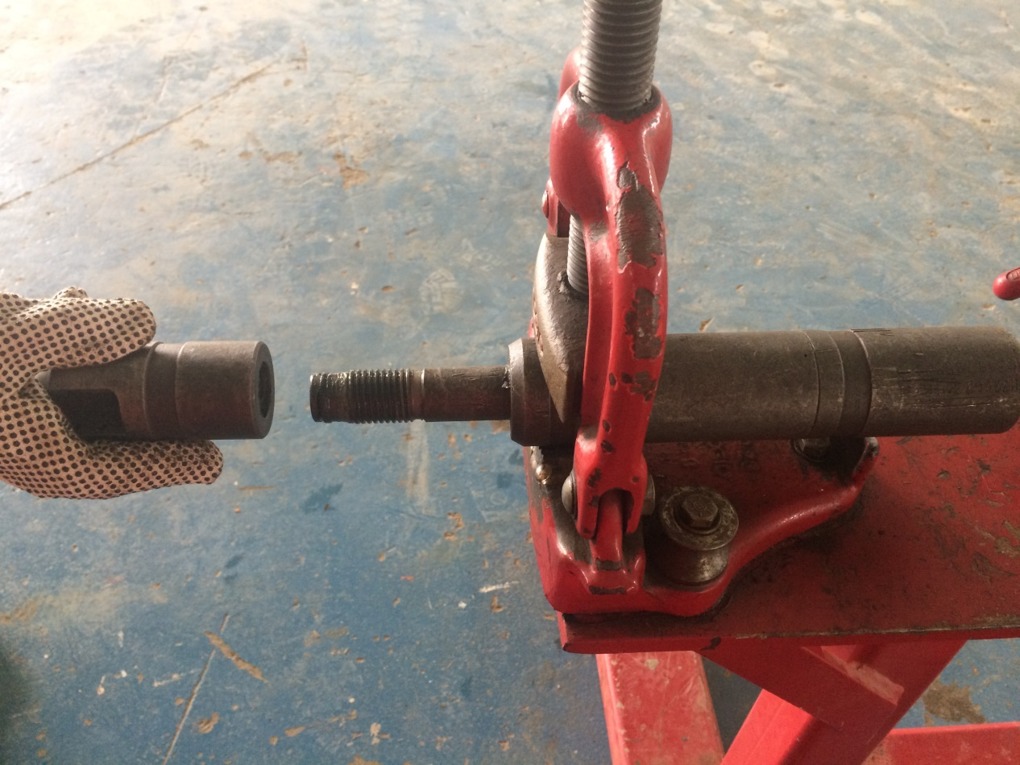
Disassembly
1- Unscrew the Nozzle , to the mandrel or nozzle sub .
Top sub
A
B
nozzle
Mandrel

Slide 7
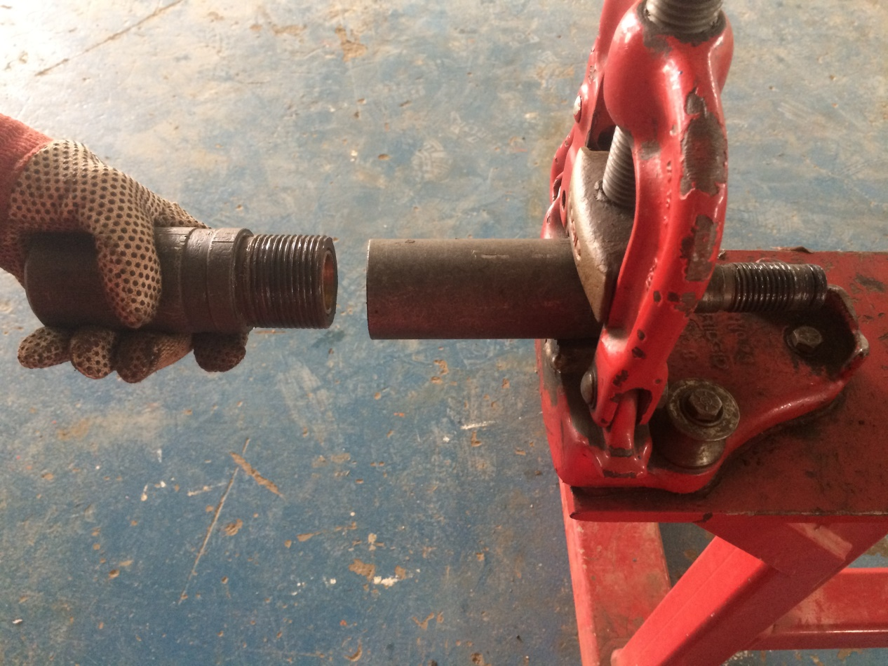
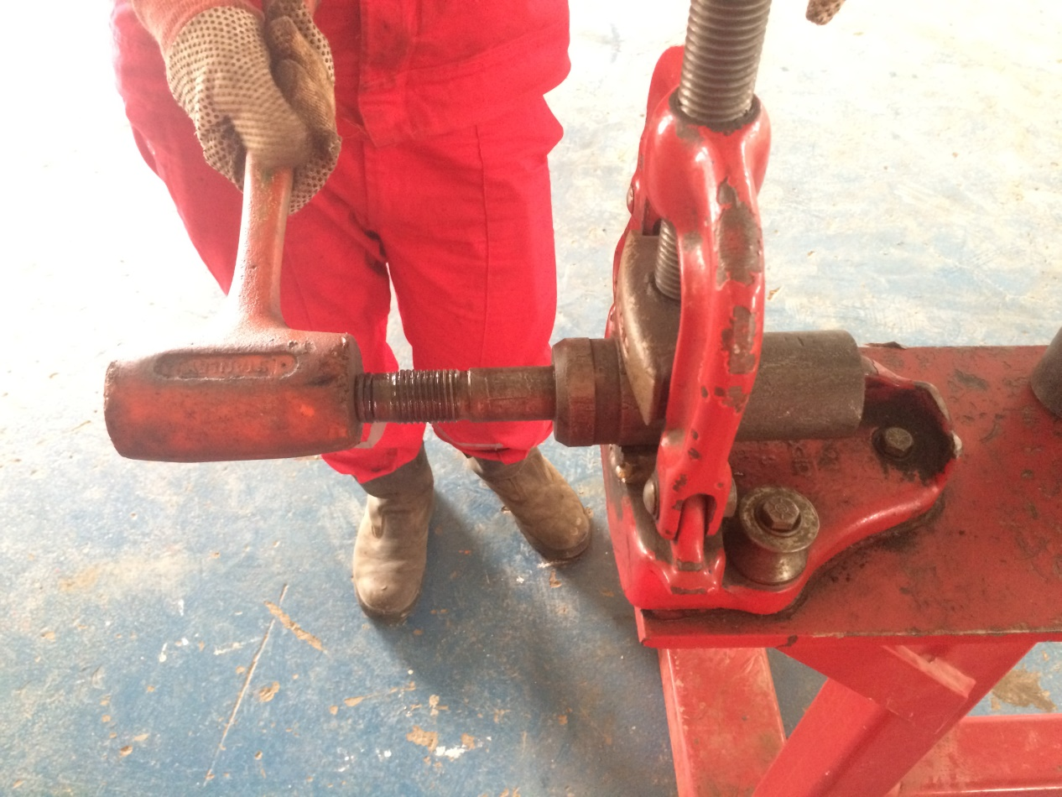
2- Unscrew the top sub and the body.
A
B
Top sub
Mandrel

Slide 8
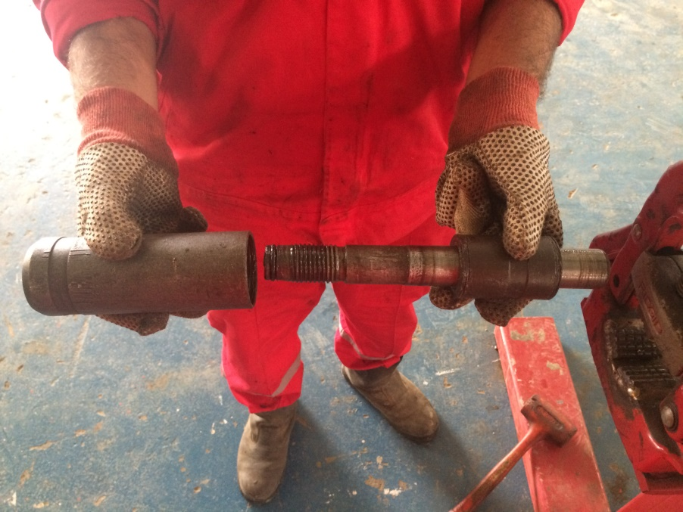
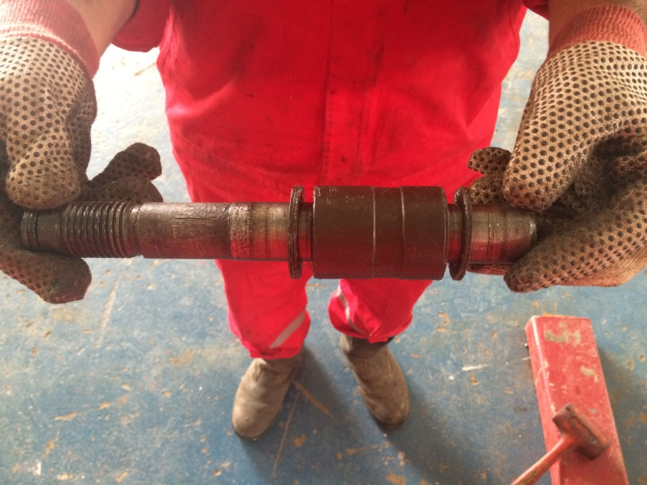
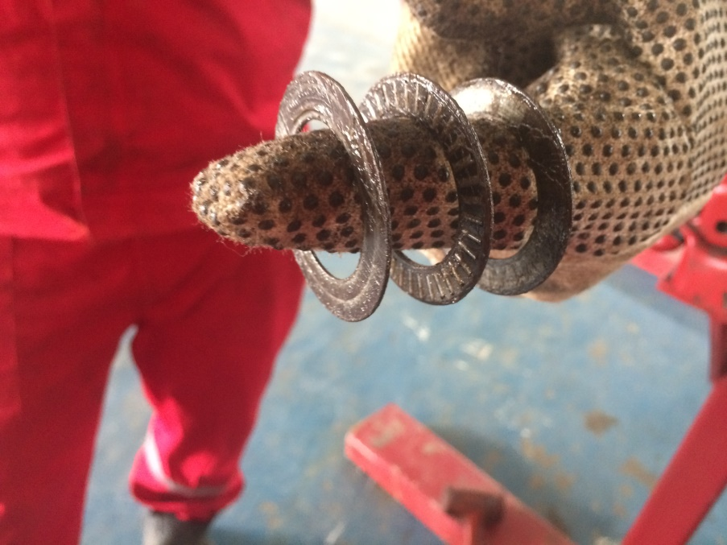
3- remove the body , thrust washers and thrust pin bearing from the mandrel . ( Notice : Do not remove the bushings from the body and top sub unless it needs to be replaced .)
A
B
C
pin bearing
body
mandrel
washers

Slide 9
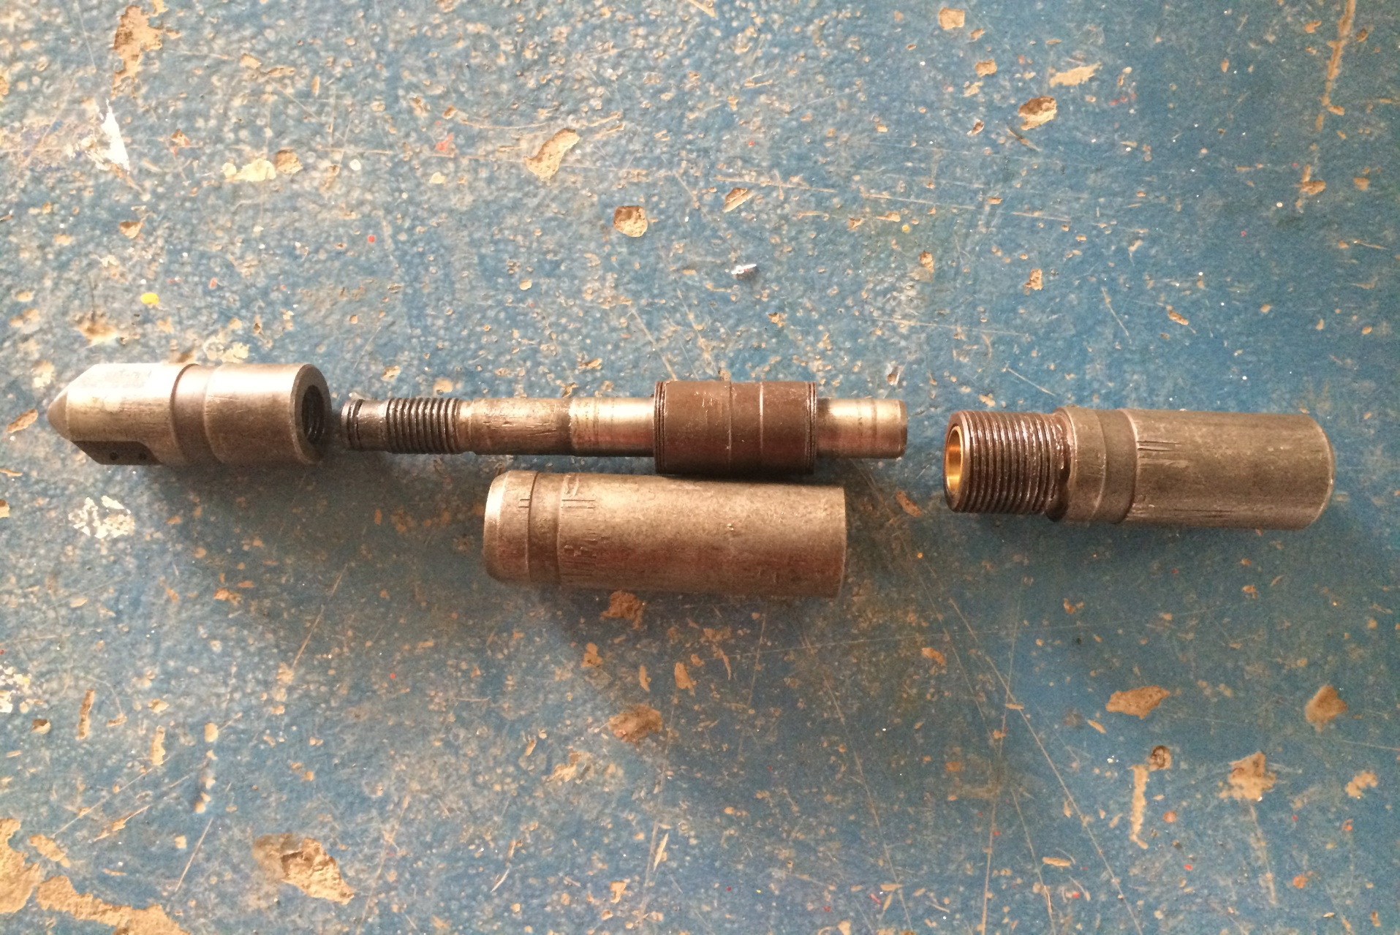
nozzle
Bottom sub
body

Slide 10
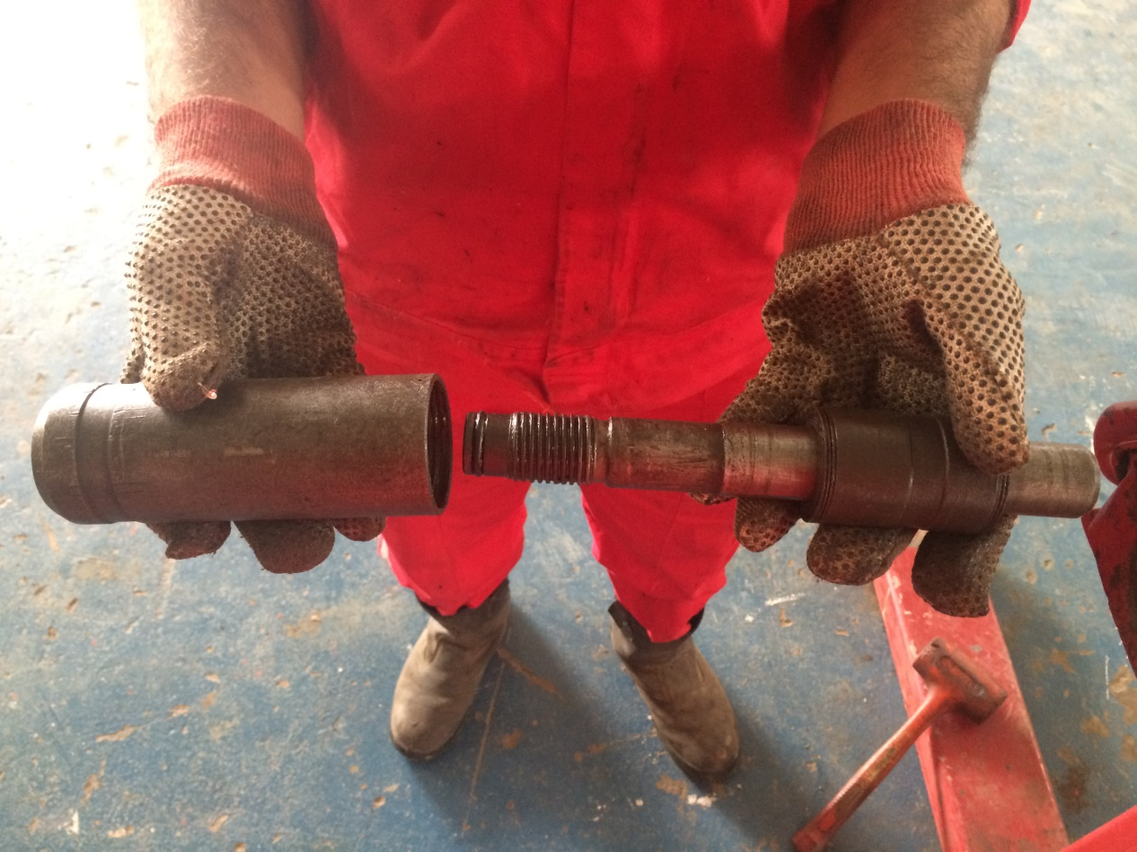
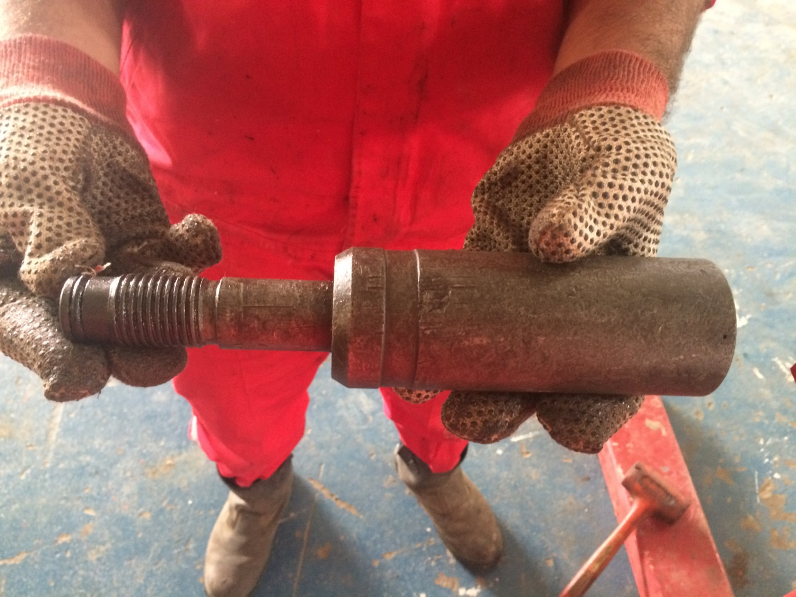
1- Slide the bushings onto both ends of the mandrel . 2- slide body onto the mandrel .
Assembly
A
B
body
mandrel

Slide 11
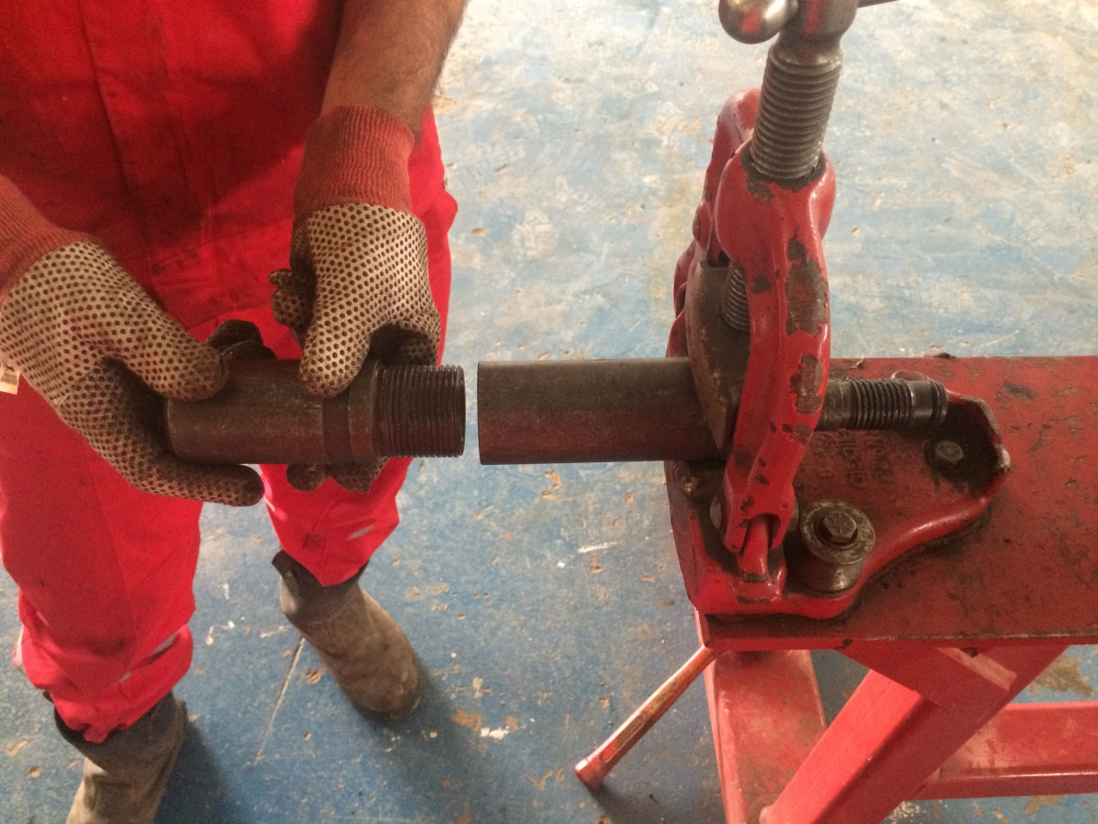
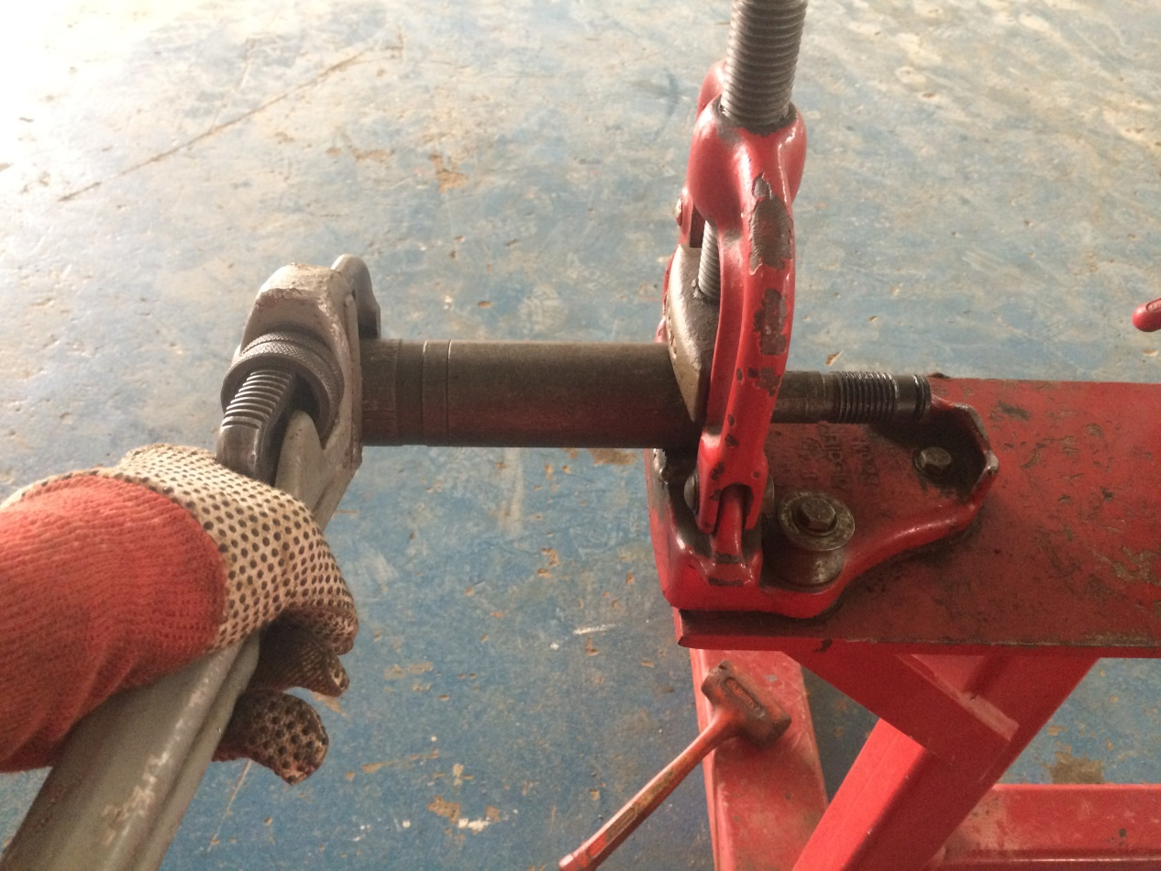
3- Make up the top sub to the body .
A
B
mandrel
Bottom sub

Slide 12
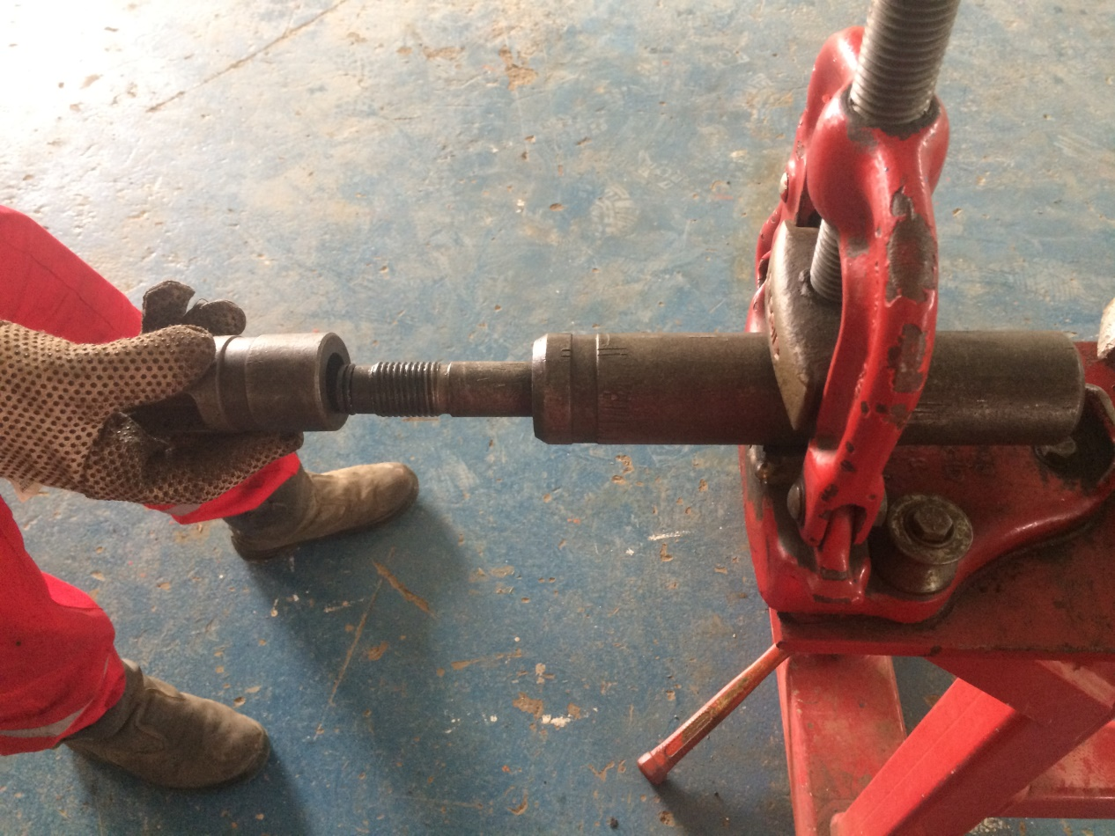
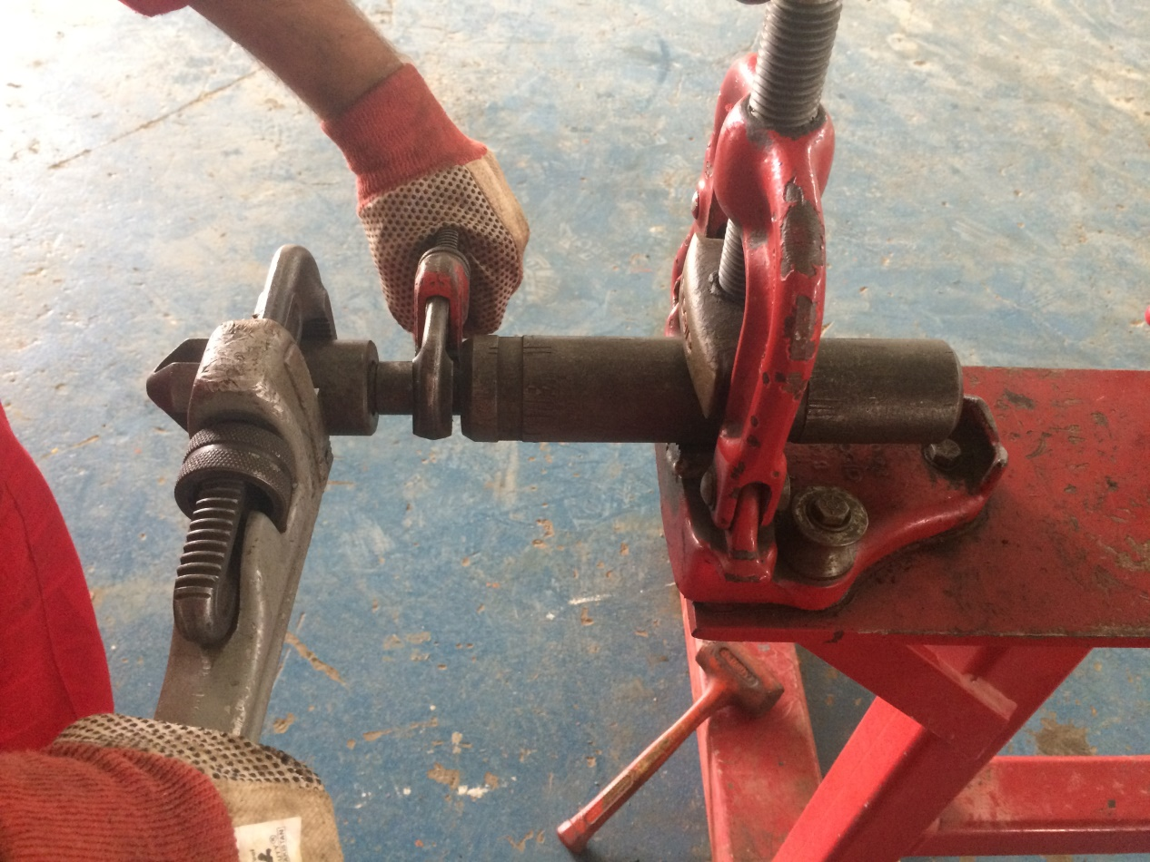
4- Make up the nozzle to the mandrel
A
nozzle
B
mandrel

